Slide 1
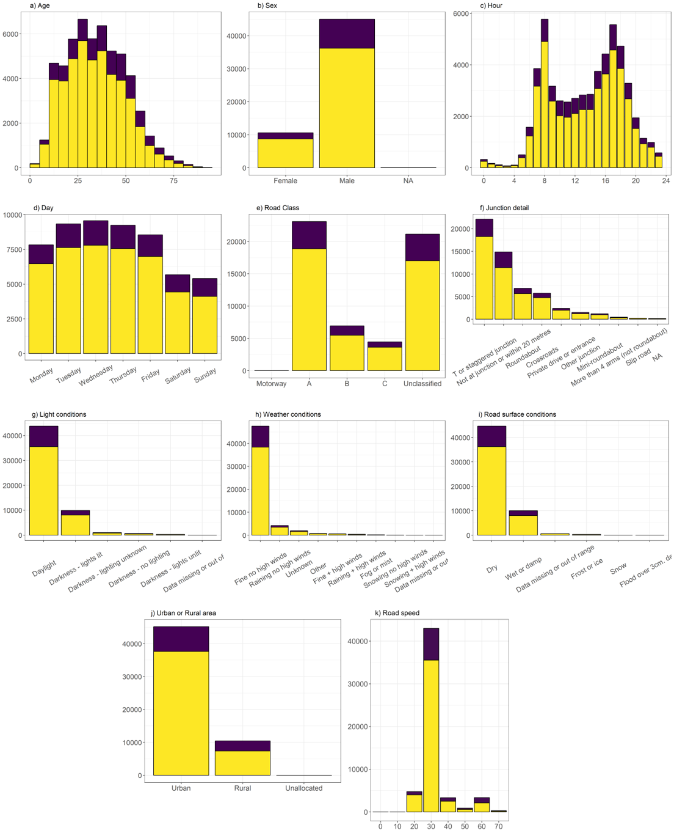
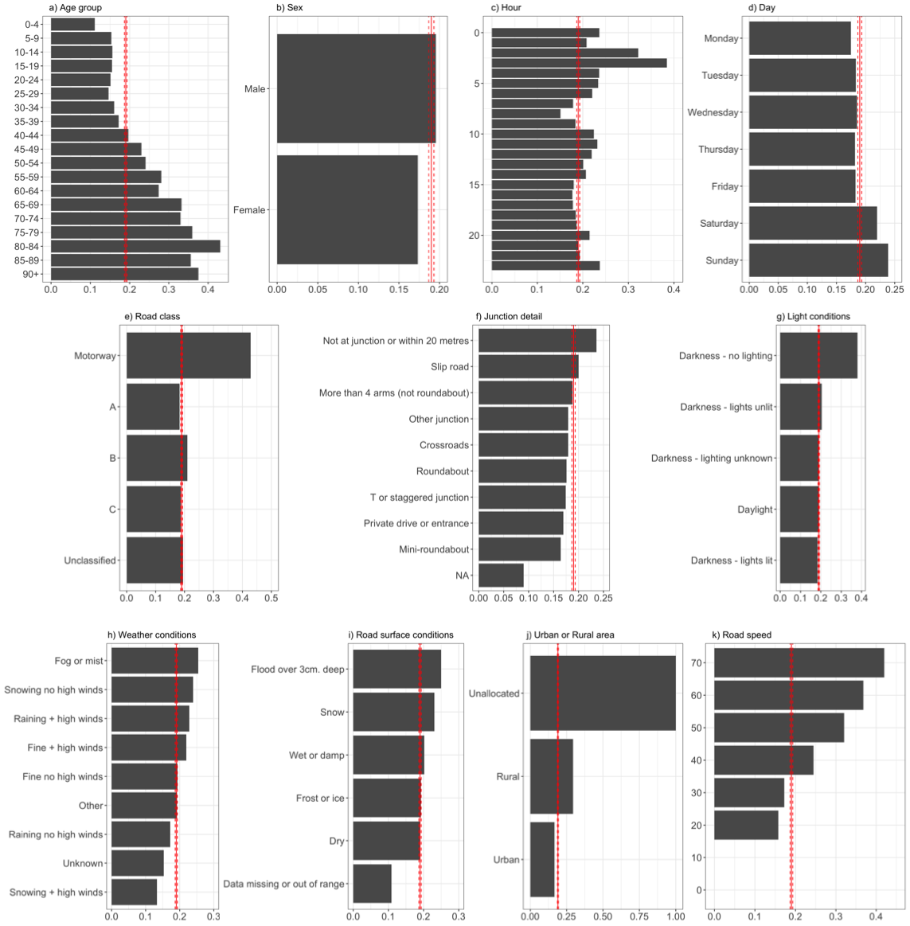
What road and ambient factors are associated with whether a cyclist casualty is killed or seriously injured in a road traffic collision?
Caroline Tait, University of Leeds
Background
Biggest barrier to the normalisation of cycling in the UK is the perceived lack of safety (Thornton et al., 2011).
On average 2 cyclists are killed 62 are seriously injured per week (Dark, 2018).
Fig 1: Number of cyclist casualties by variable who were KSI (purple) or non-KSI (yellow)
Methods
Road Traffic Accident dataset 2015-2017
Outcome of interest – whether cyclist casualty was killed or seriously injured (KSI) or slightly injured (non-KSI)
Variables of interest – cyclist age and sex; hour and day of accident; road class, speed, location and junction details; road surface, light and weather conditions
Analysis method: Logistic regression
Results
55,642 cyclist casualties between 2015-2017
19% KSI overall
Number of casualties and proportion of those KSI vary considerably by the various factors (see Figures 1 and 2)
Odds ratio (p≤0.002) of being KSI v non-KSI higher if:
Male (OR 1.10)
On a weekend (Saturday 0.19, Sunday 0.24)
In darkness with no lighting (1.48) or in darkness when lights are lit (1.11)
Roads are wet or damp (1.14)
On a road with a speed greater than 40mph (1.44), 50mph (1.74), 60mph (1.80) or 70mph (2.63)
As age increases by 1 year, OR increases by 1.02
BUT
OR is reduced when accident is at most forms of
junction (0.70 – 0.90) and in rain with no
high winds (0.81)
Fig 2: Proportion of cyclist casualties within each group by variable (red solid line is average KSI proportion and dashed lines are 9% confidence interval for that proportion
Conclusions
Vast majority of collisions resulting in cyclist casualties occur in daylight, fine weather, on dry, urban roads with a speed limit of 30mph.
The proportion of KSI was higher for males, older people and collisions on the weekends, in darkness, on rural, open roads and with higher road speed.
Road speed limit was the most important factor in increasing the OR for being KSI whilst being hit near a junction was the most protective.
It is likely that quality cycling infrastructure could address the issues around road factors and mitigate others such as weather issues.
Discussion
The analysis performed did not take into account interaction between the variables such as raining AND wet road surface.
Important other variables were not considered such as nature of the vehicles involved.
An analysis of rates per billion km cycled would aid interpretation
References:
Dark, M. 2018. Pedal Cycling Road Safety Factsheet. [Online]. Department for Transport.
Thornton, A., Evans, L., Bunt, K., Simon, A., King, S. and Webster, T. 2011. Climate Change and Transport Choices Segmentation Model-A framework for reducing CO2 emissions from personal travel.[Online]

